Slide 1
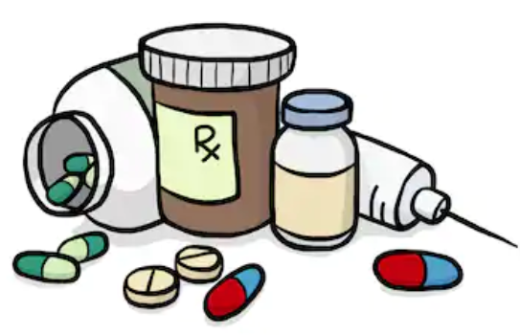
Antibiotic Prescribing
Kishan Mistry MPharm BDS

Slide 2
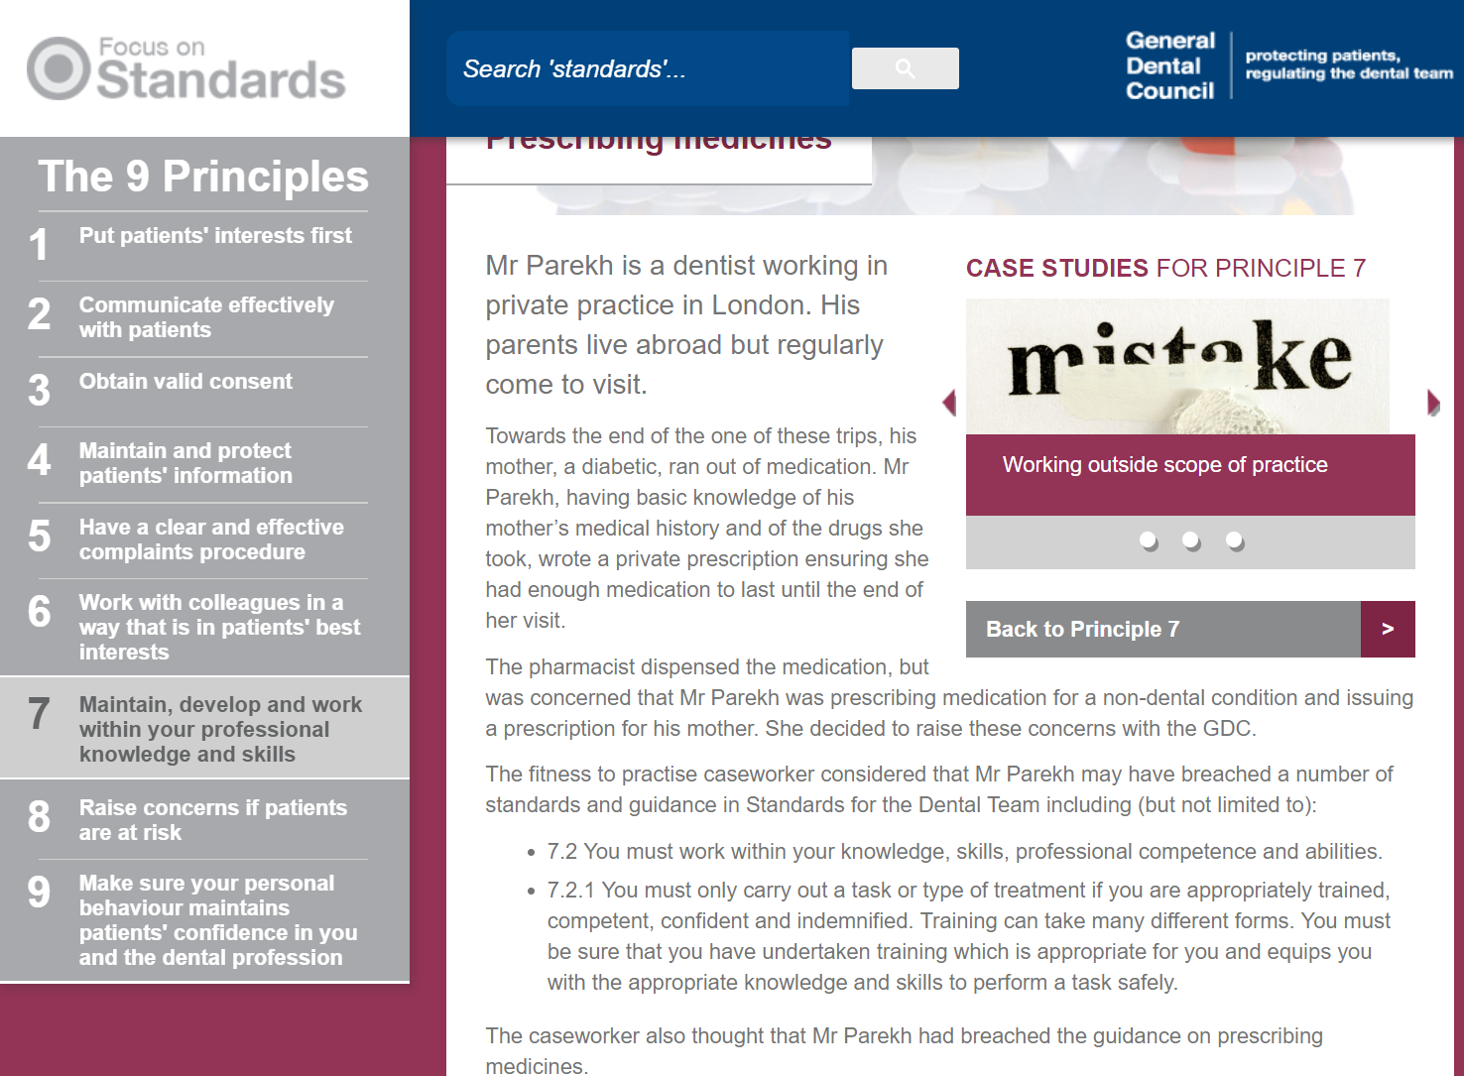
Prescribing

Slide 3
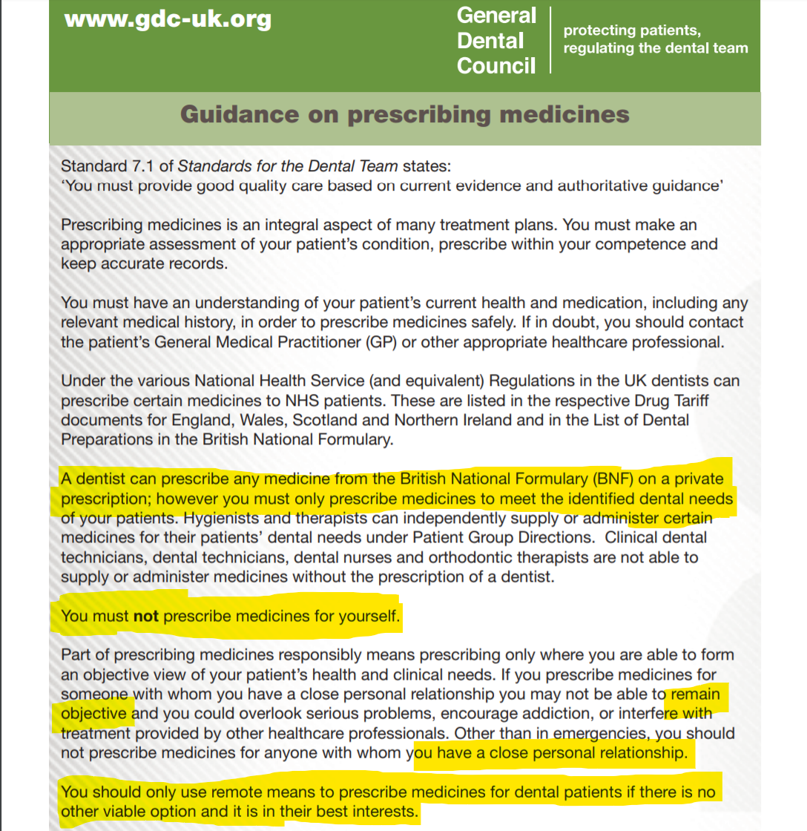

Slide 4
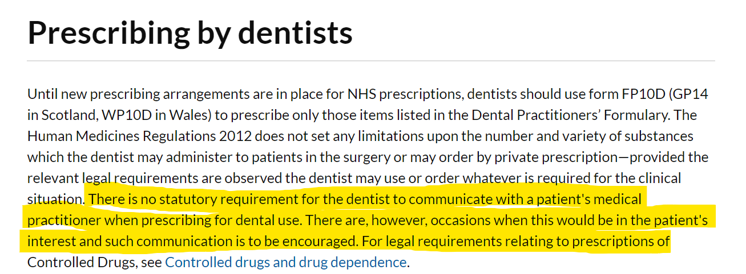
NICE

Slide 5
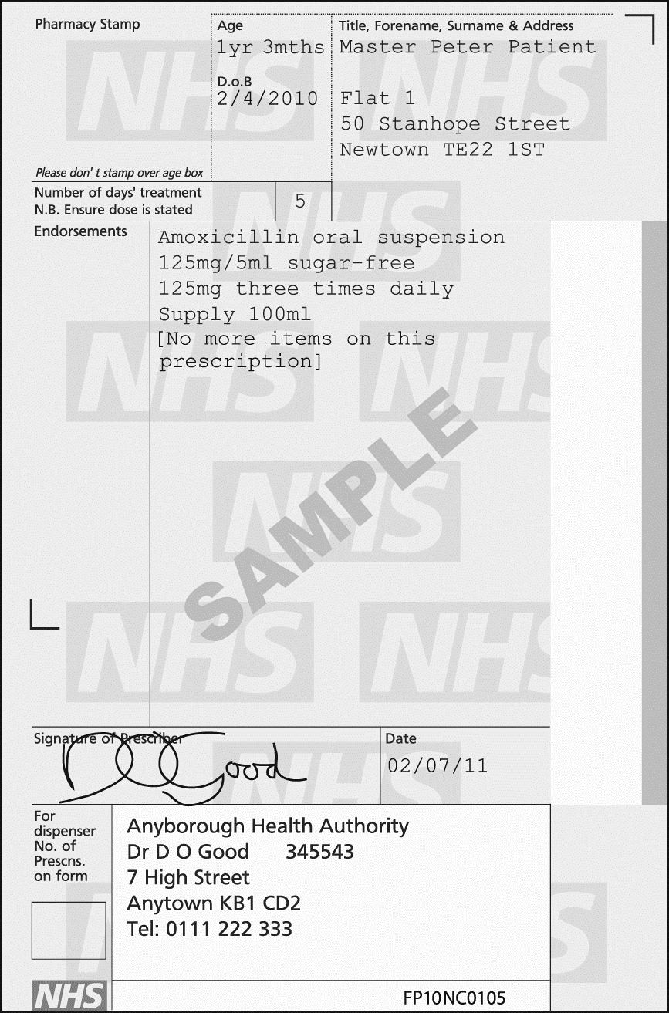
Prescription requirements
Formulation and strength clearly stated
Avoid unnecessary decimal points
Avoid abbreviating nanograms and micrograms
Dose and dose frequency stated
Care should be taken to ensure children receive the correct dose of the active drug. Therefore, the dose should normally be stated in terms of the mass of the active drug (e.g. ‘125 mg 3 times daily’); terms such as ‘5 mL’ or ‘1 tablet’ should be avoided except for compound preparations
9Name of drug
Quantity
Directions preferably in English without abbreviations
Notes:
Alteration > sign and date it
Not uncommon to hear from local pharmacists

Slide 6
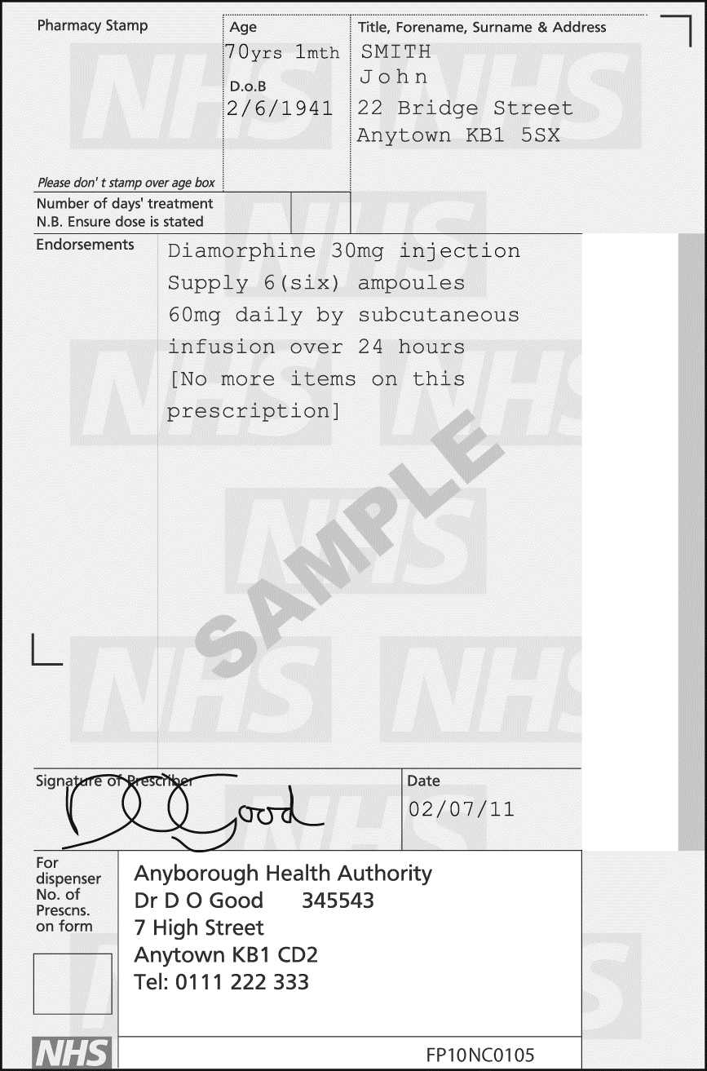
Controlled Drugs
The Misuse of Drugs Regulations 2001 (and subsequent amendments) defines the classes of person who are authorised to supply and possess Controlled Drugs while acting in their professional capacities and lays down the conditions under which these activities may be carried out. In the 2001 regulations, drugs are divided into five Schedules, each specifying the requirements governing such activities as import, export, production, supply, possession, prescribing, and record keeping which apply to them.
Temazepam is a Schedule 3 CD
Diazepam is a Schedule 4 CD
the words ‘for dental treatment only’ if issued by a dentist.
for liquids, the total volume in millilitres (in both words and figures) of the preparation to be supplied; for dosage units (tablets, capsules, ampoules), state the total number (in both words and figures) of dosage units to be supplied (e.g. 10 tablets [of 10 mg] rather than 100 mg total quantity)

Slide 7
Prescription and NHS dental exemptions
Patients often confused – often think they are the same
Watch out for:
Over 60s
Medical exemption certificates
Pre-payment certificates

Slide 8
Electronic prescriptions
Electronic prescriptions service (EPS)
Reliable, secure, confidential
Paper free, time efficient
Tracking, fraud
Future?

Slide 9
Antibiotics
Antibacterials
Target bacterial function
Cell Wall – Penicillins, Cephalosporins
DNA – Metronidazole
Ribosomes – Macrolides, Lincosamides, Tetracyclines, Fusidic Acid

Slide 10
Bactericidal or bacteriostatic
Bactericidal – an agent that kills bacteria
Penicillins
Cephalosporins
Metronidazole
Bacteriostatic – an agent that prevents bacterial growth but does not necessarily kill them.
Macrolides
Lincosamides
Tetracyclines
Fusidic acid

Slide 11
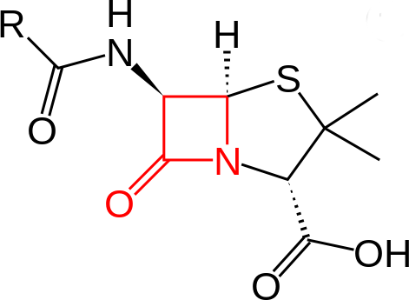
Penicillins
Amoxicillin, phenoxymethylpenicillin
Beta-lactams – prevent peptidoglycan cross linking in bacterial cell walls

Slide 12
Penicillins
Amoxicillin – Broad spectrum antibiotics, dental abscesses
Phenomethylpenicillin – narrow spectrum
Co-amoxiclav
Combination of amoxicillin and clavulanic acid (inhibits beta-lactamase enzymes)

Slide 13
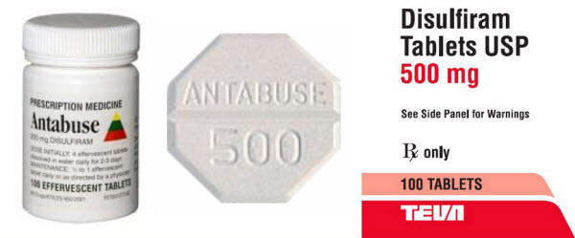
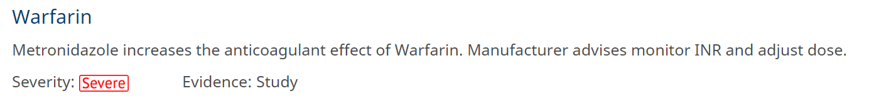
Metronidazole
Bactericidal – effective against anaerobic bacteria
Side effect > Disulfiram-like reaction
NO ALCOHOL
Used for dental abscesses (penicillin allergies), NUG and
pericoronitis

Slide 14
Macrolides
Bacteriostatic – inhibits protein synthesis at bacterial ribosomes
Many interactions – statins
Erythromycin no longer recommended by FGDP
Clarithromycin – dento-alveolar infections
Azithromycin – dento-alveolar infections

Slide 15
Lincosamides
Clindamycin
Same mechanism has macrolides
Some evidence that pre-operative prophylaxis significantly reduces implant failure

Slide 16
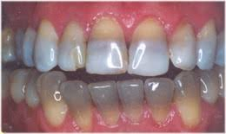
Tetracyclines
Bacteriostatic – inhibits protein synthesis at bacterial ribosomes
Do not give to children under 12 years – deposition in growing bone and teeth by binding to calcium, causes staining and dental hypoplasia
Avoid in pregnancy + breast feeding
Doxycycline – OAC/OAF, also adjunct to RSD in chronic periodontitis

Slide 17
Fusidic Acid
Inhibits bacterial protein synthesis
Narrow spectrum antibiotic
Useful for angular chelitis

Slide 18

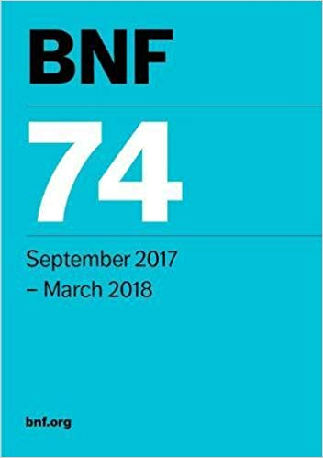

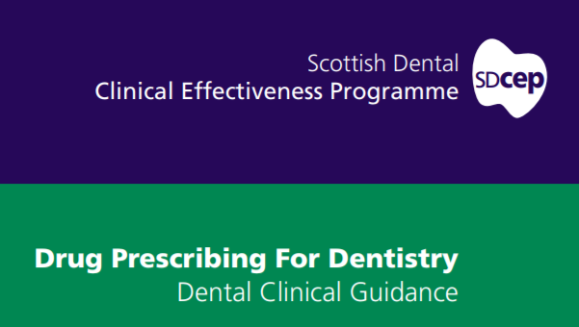

Guidance

Slide 19
General rule
Drain and remove source of infection
Antibiotics:
Signs of systemic spread of infection
Immunocompromised patient
Treatment needs to be delayed

Slide 20

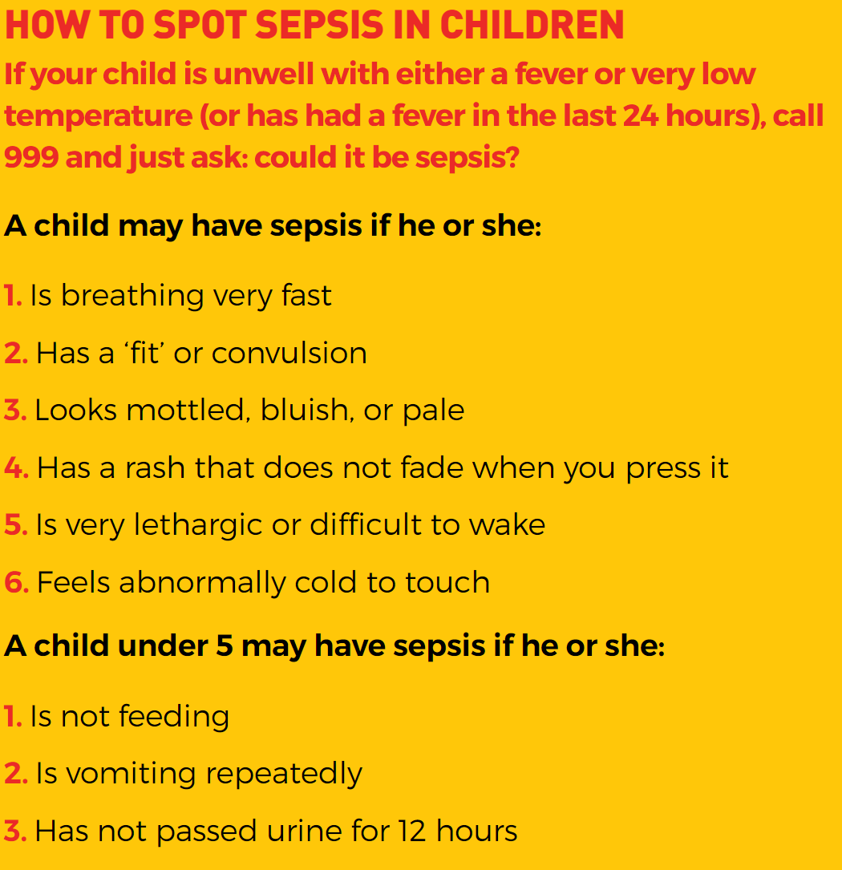
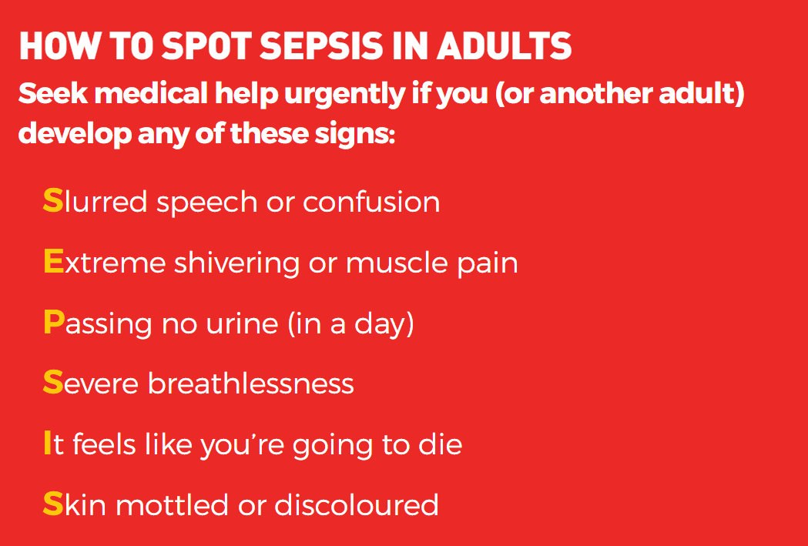
Sepsis
Overreaction to an infection – life threatening
Temp >38ºC or <36ºC, HR >90/min, RR >20/min

Slide 21
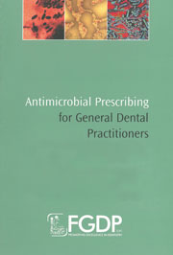
Follow up after prescribing?
Review patient 2-3 days after drainage
Resolution of infection? Temperature normal?
Stop antimicrobials

Slide 22
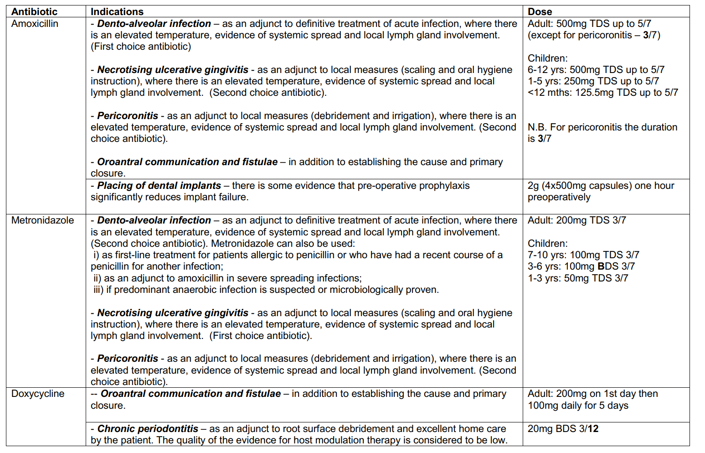
Notes:
FGDP
Body weights? > BNF

Slide 23
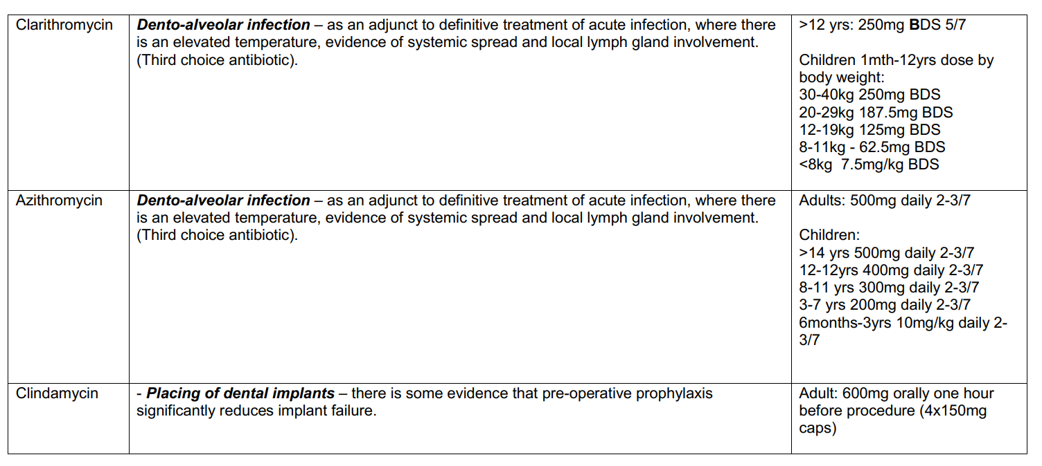

Slide 24
Infective Endocarditis
Bacterial infection of the inner lining of the heart (endocardium)
Symptoms:
Fever
weight loss, coughing
Cardiac symptoms (murmurs, heart failure)
Embolisms (>stroke)
Treated with IV antibiotics

Slide 25
Patients at increased risk of IE
• acquired valvular heart disease with stenosis or regurgitation
• hypertrophic cardiomyopathy
• previous infective endocarditis
• structural congenital heart disease, including surgically corrected or palliated structural conditions, but excluding isolated atrial septal defect, fully repaired ventricular septal defect or fully repaired patent ductus arteriosus, and closure devices that are judged to be endothelialised;
• valve replacement.
Notes:
Medical history important, anticoagulantS?

Slide 26
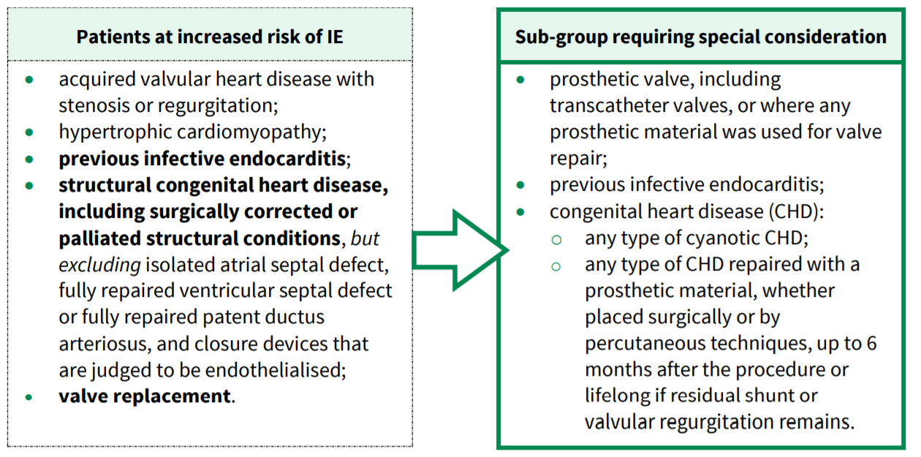
Consult with cardiology consultant, surgeon or local cardiology centre

Slide 27
Routine management
Ensure pt is aware of risks and provide prevention advice:
Potential benefits and risks of antibiotic prophylaxis
Explain they are not routinely recommended
Importance of good OH
IE symptoms
Risk of undergoing invasive procedures
Record in notes
If patient requests antibiotics > seek advice from cardiologist

Slide 28
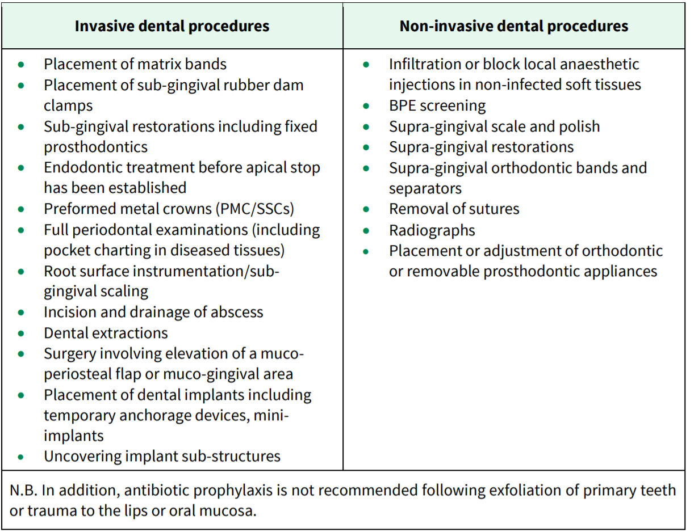

Slide 29
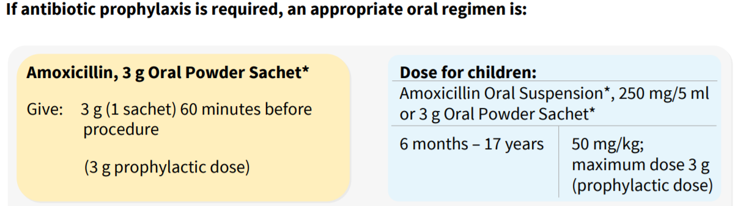

Slide 30
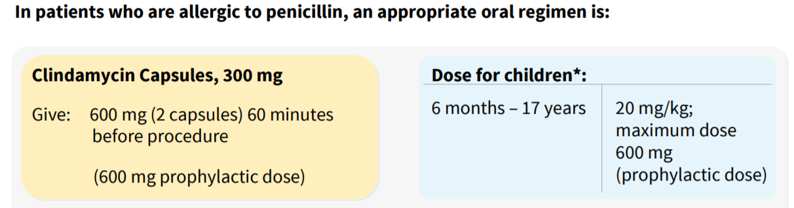

Slide 31
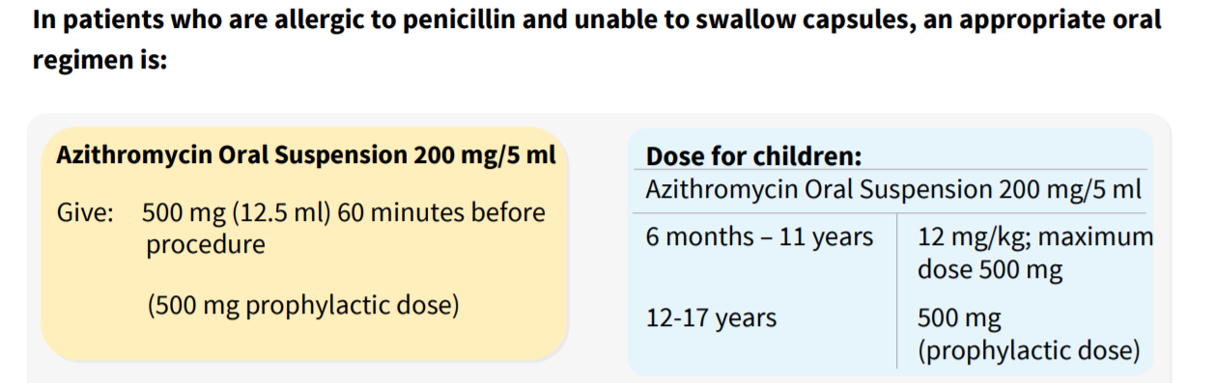

Slide 32
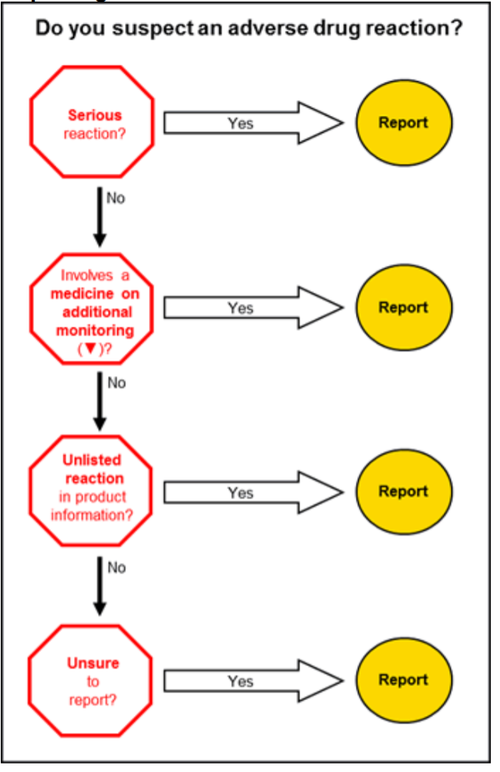
Yellow Card System
Medicines and Healthcare products Regulatory Agency (MHRA)
Pharmacovigilance – practice of monitoring the effects of medical drugs after they have been licensed for use in order to identify and evaluate previously unreported adverse reactions

Slide 33
Black Triangle Scheme
New medicines and vaccines that are under additional monitoring have an inverted black triangle symbol (▼)
This symbol appears next to the name of a relevant product:
in the British National Formulary (BNF)
in the British National Formulary for Children (BNFC)
in Monthly Index of Medical Specialties (MIMS)
in the Association of the British Pharmaceutical Industry (ABPI) Medicines Compendium
on advertising material
in Drug Safety Update
in summaries of product characteristics and patient information leaflets

Slide 34
Specific areas of interest to report suspected ADRs
Children
- Pharmacodynamics and pharmacokinetic
Many drugs routinely used in children but not extensively tested ‘off-label uses’
Drugs may affect the way a child grows – delayed adverse ADR
Available formulations may not allow precise dosing in children
Over 65s
- More susceptible to developing reactions as metabolism is less effective, more sensitive to effects

Slide 35
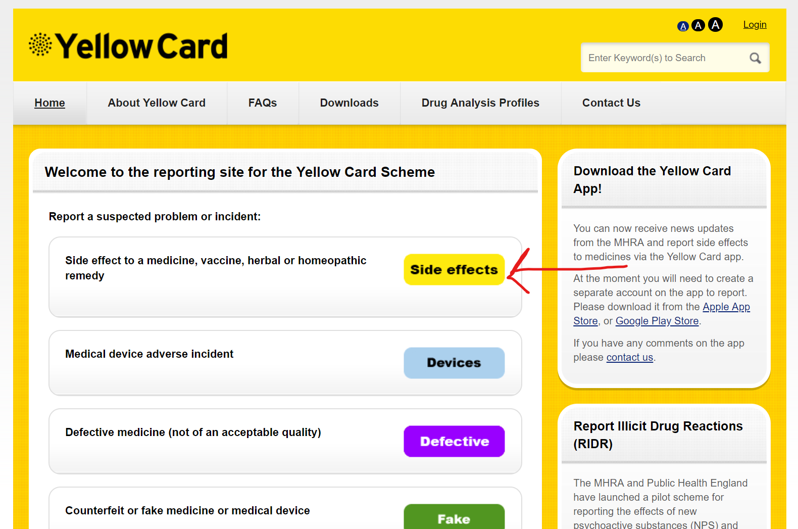

Slide 36
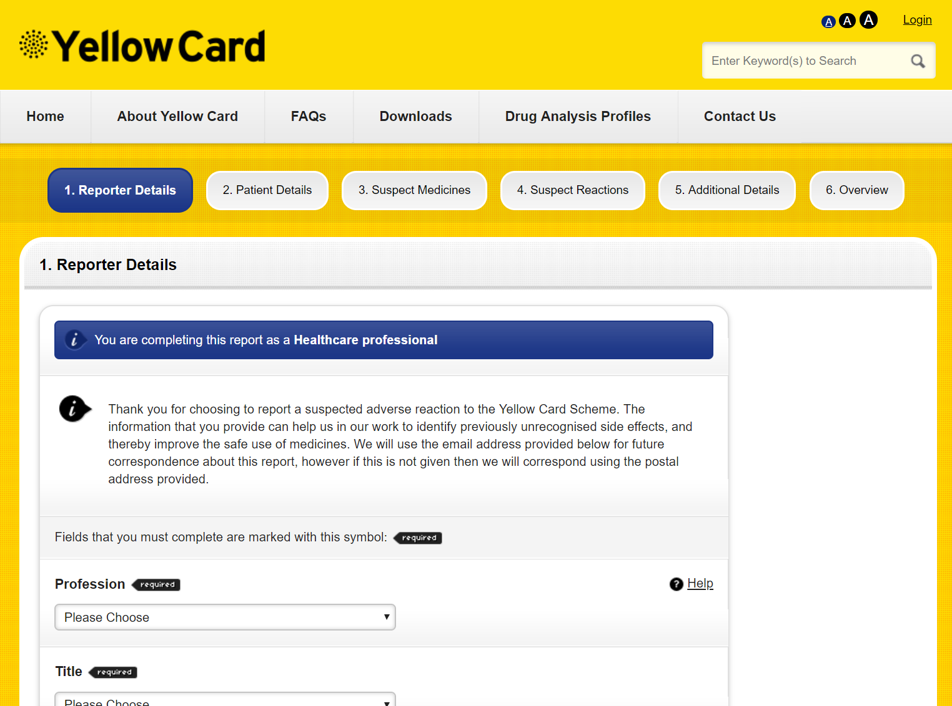

Slide 37

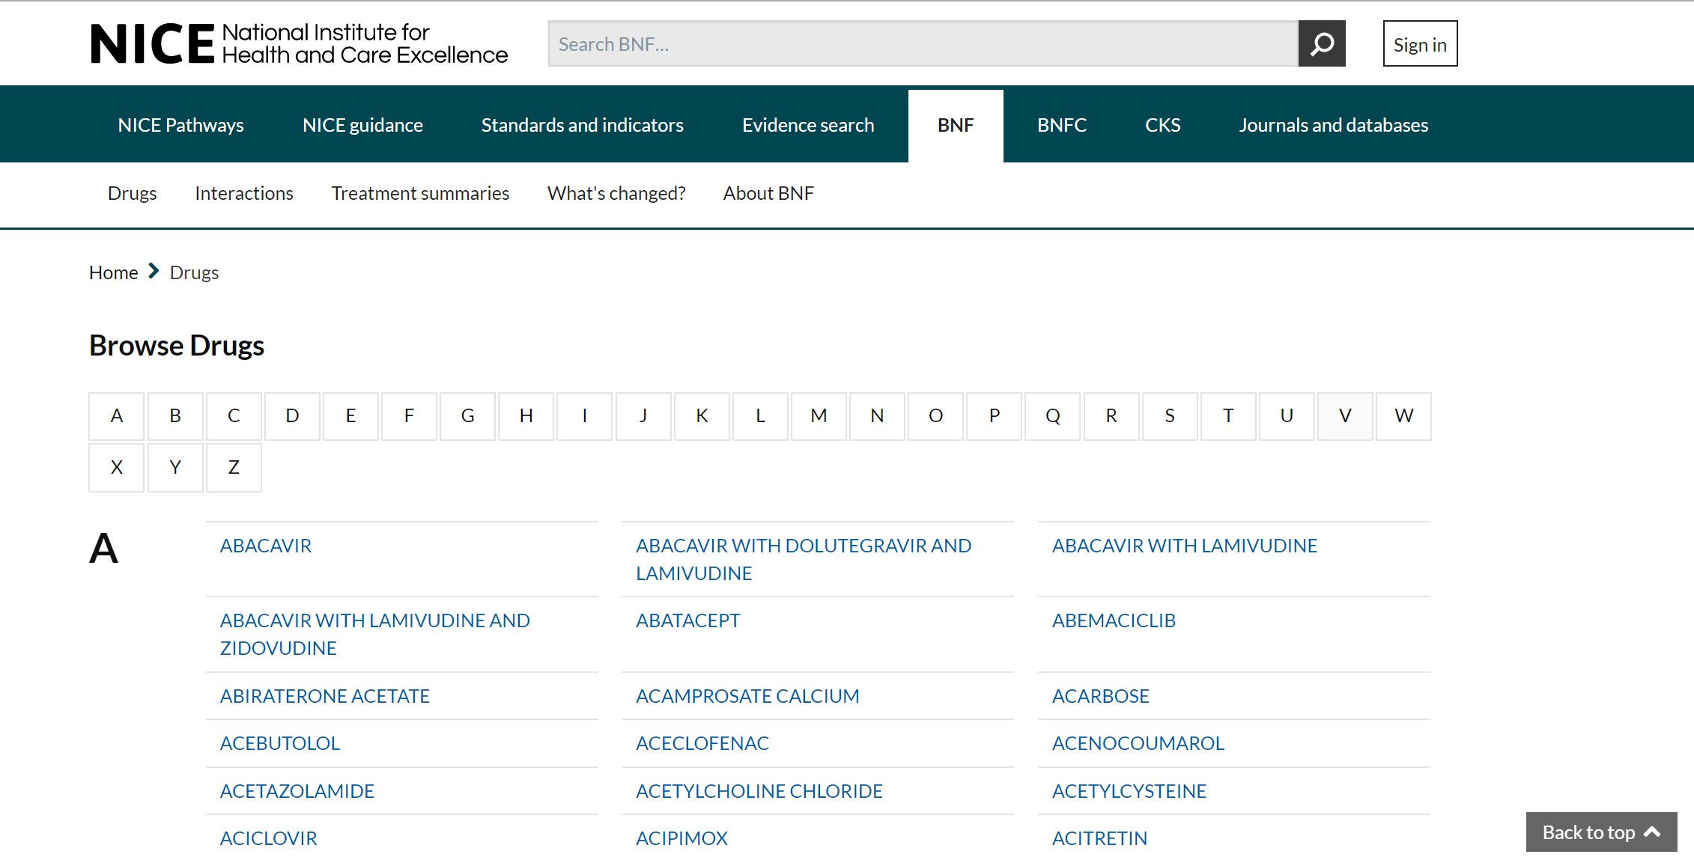
Drug Interactions

Slide 38
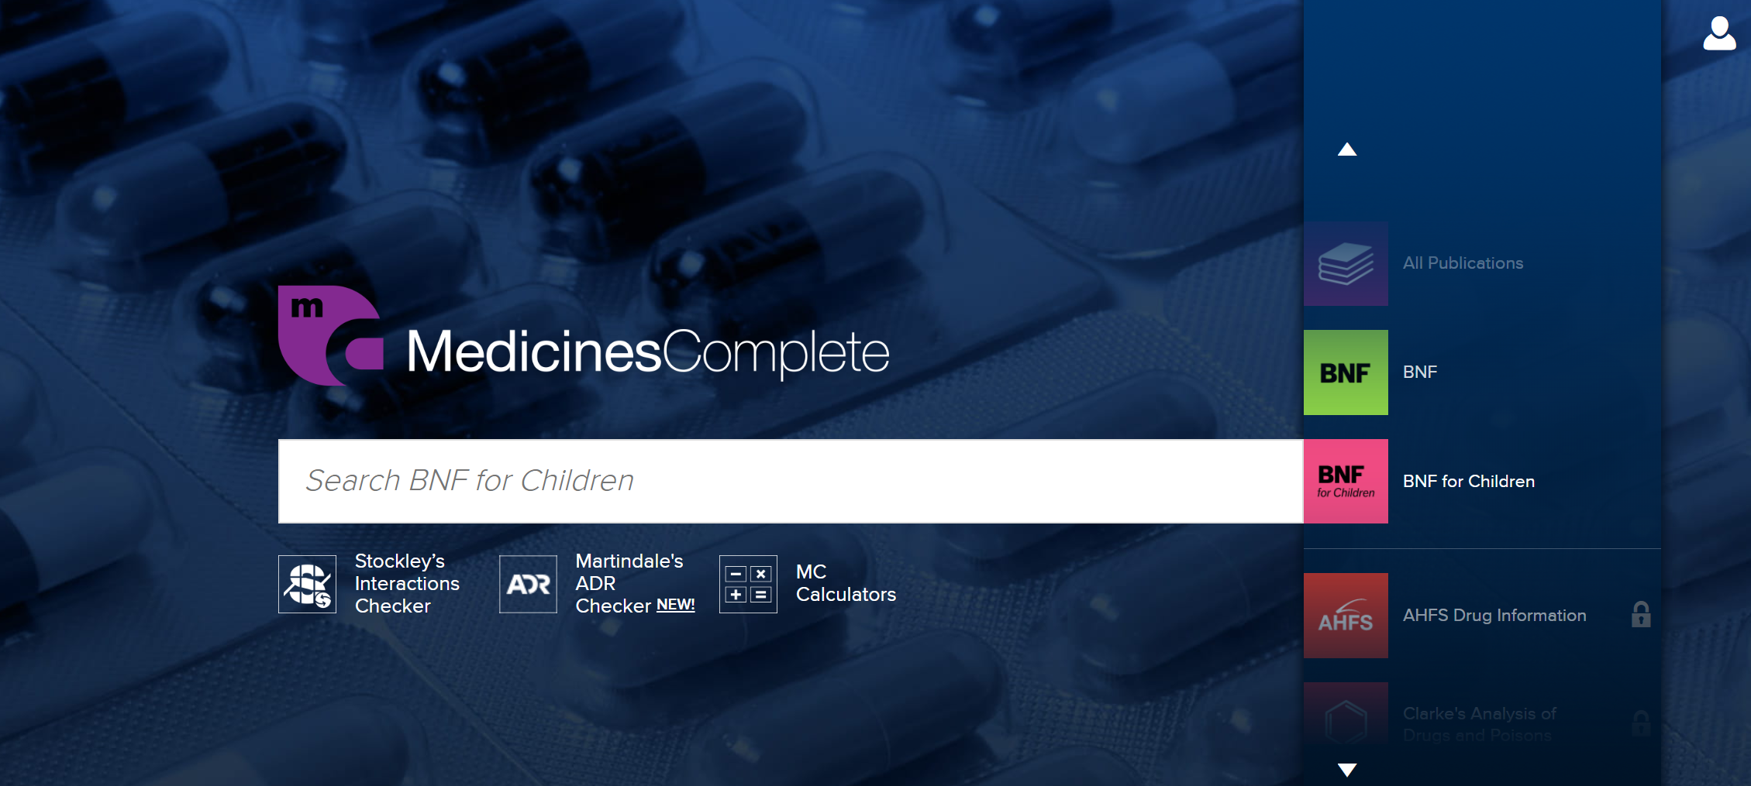

Slide 39
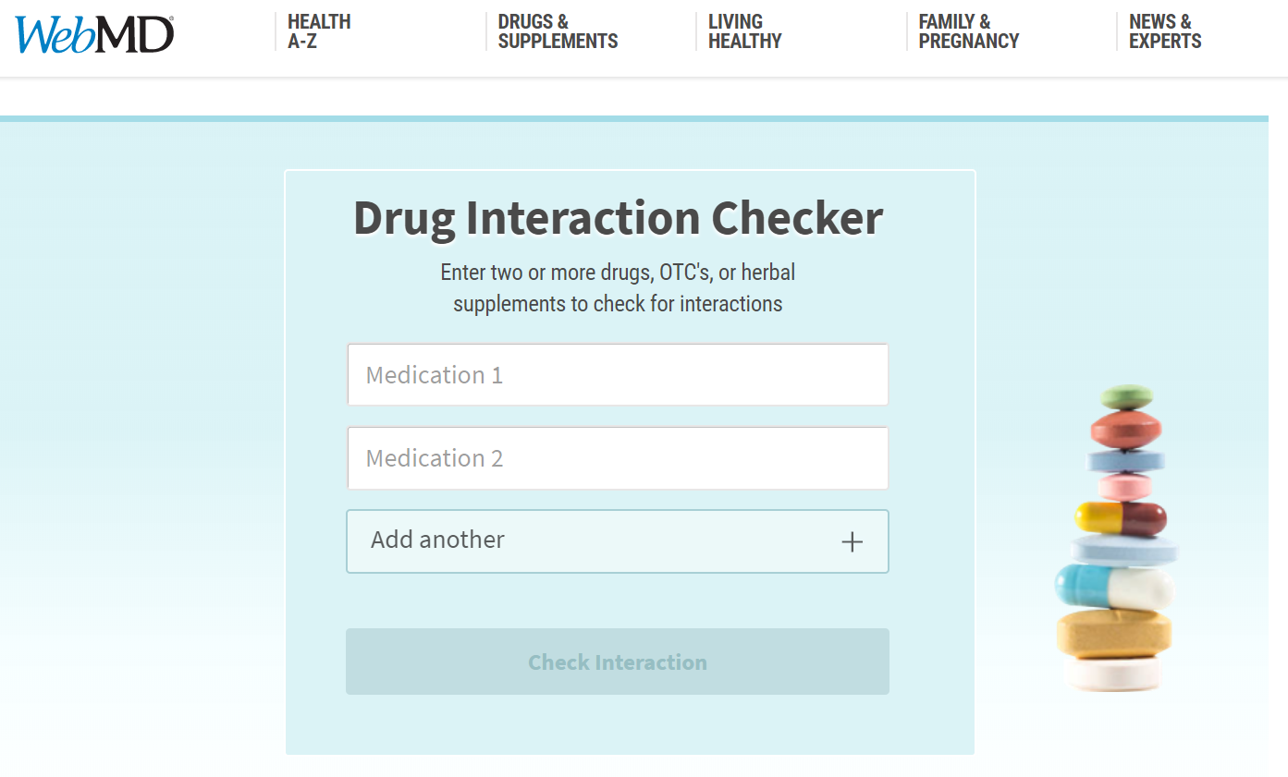
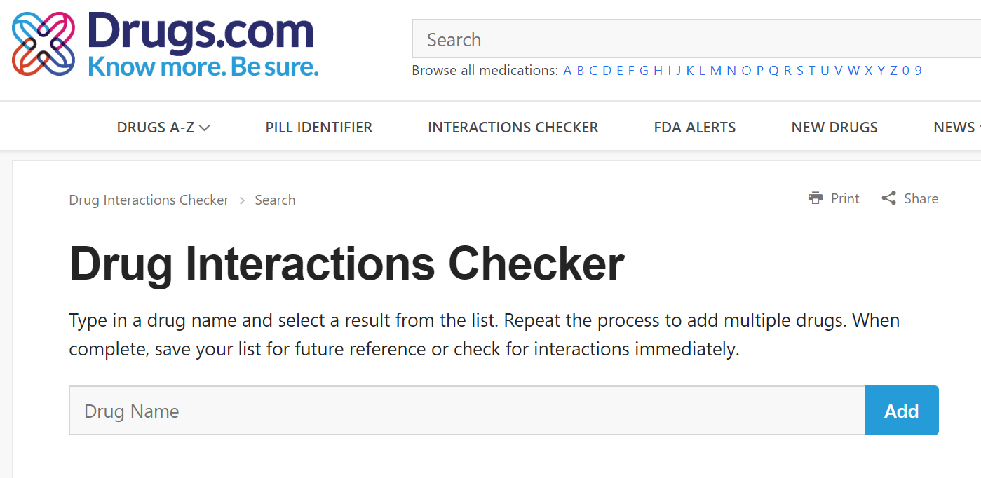
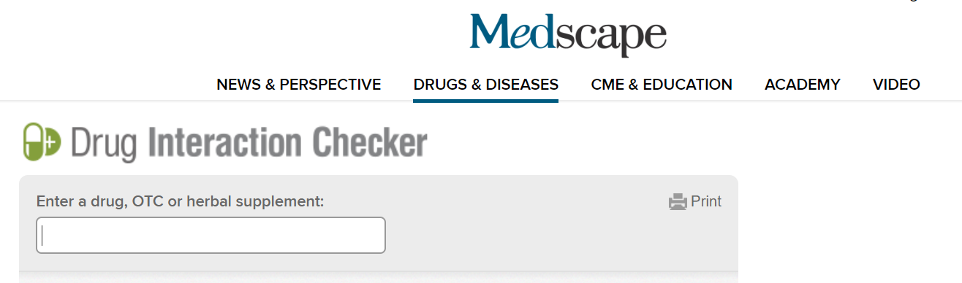

Slide 40

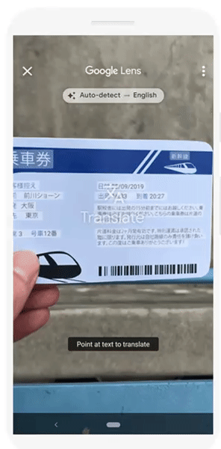
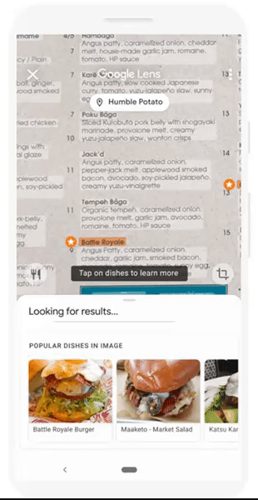

Google Lens

Slide 41
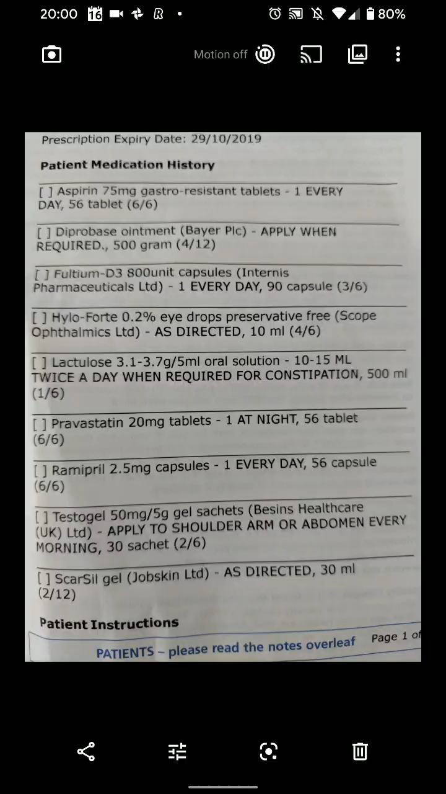

Slide 42
Levels of severity
SEVERE – the result may be a life-threatening event or have a permanent detrimental effect.
MODERATE – the result could cause considerable distress or partially incapacitate a patient; they are unlikely to be life-threatening or result in long-term effects.
MILD – the result is unlikely to cause concern or incapacitate the majority of patients.
UNKNOWN – used for those interactions that are predicted, but there is insufficient evidence to hazard a guess at the outcome.
Notes:
Replaces black dot interactions

Slide 43
Level of evidence
STUDY – for interactions where the information is based on a formal study including those for other drugs with the same mechanism (e.g. known inducers, inhibitors, or substrates of cytochrome P450 isoenzymes or P-glycoprotein).
ANECDOTAL – interactions based on either a single case report or a limited number of case reports.
THEORETICAL – interactions that are predicted based on sound theoretical considerations. The information may have been derived from in vitrostudies or based on the way other members in the same class act.
Notes:
Stockley’s drug interaction

Slide 44
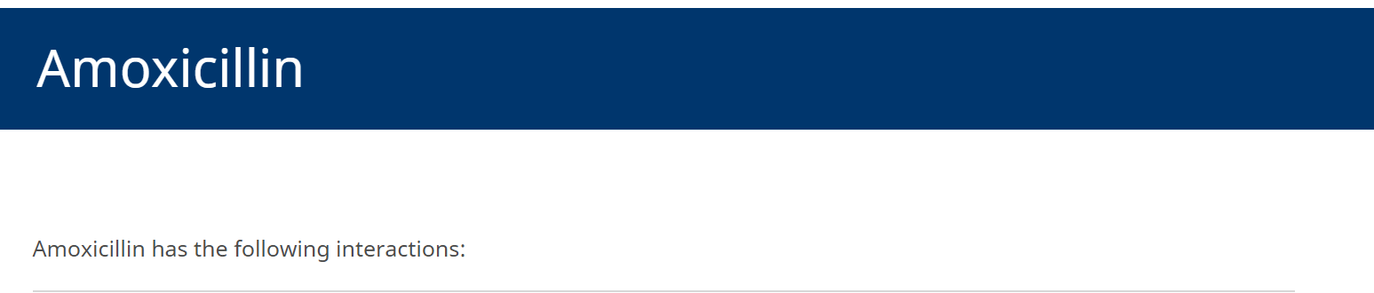
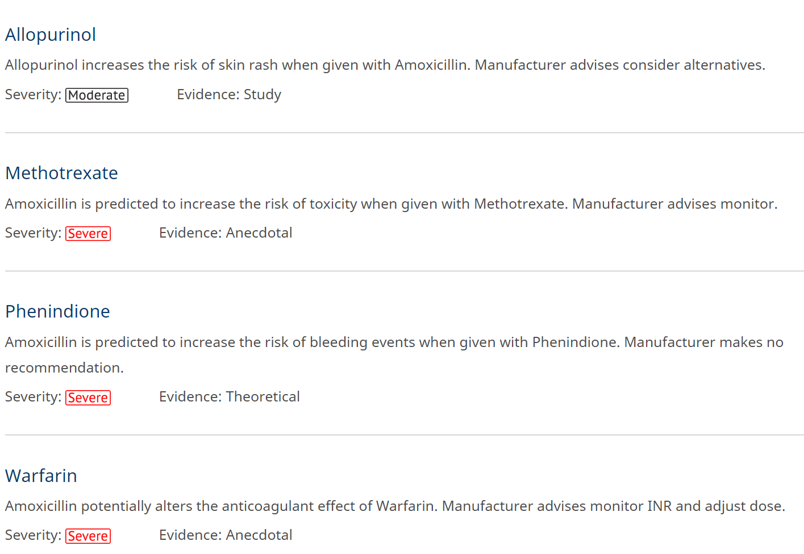
Notes:
Tell patient, document in notes

Slide 45
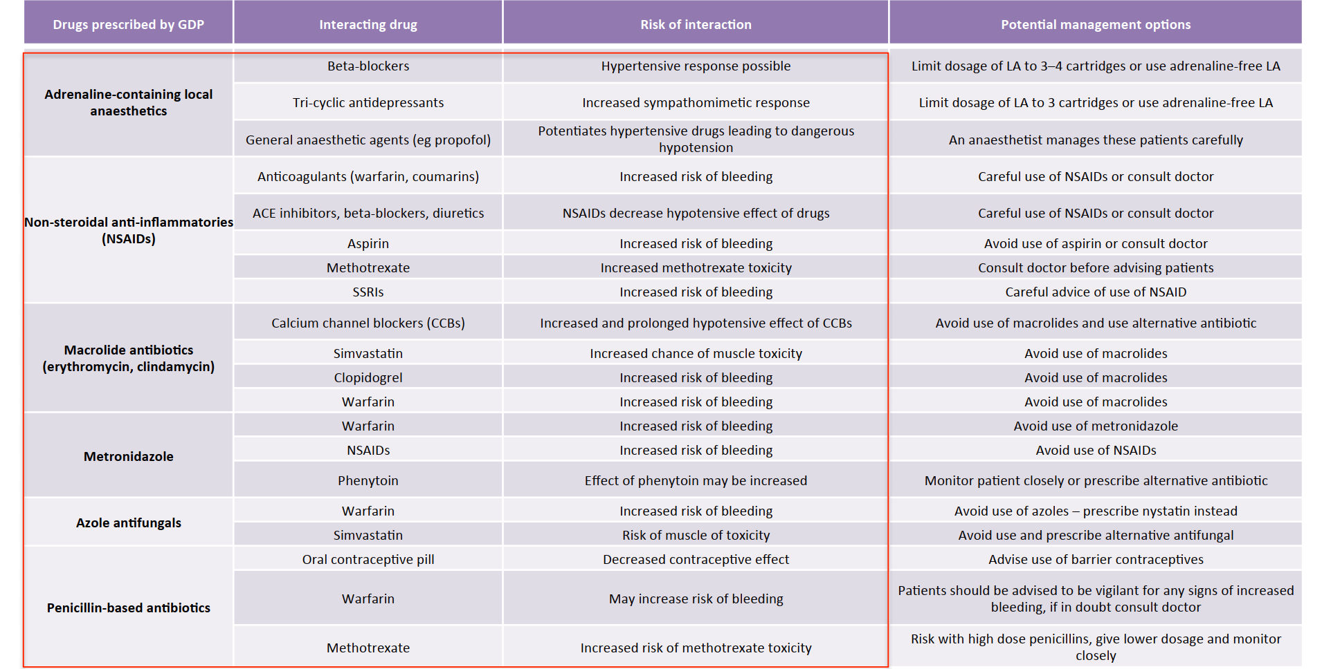
Notes:
Azole + warfarin
OC + amox – no longer issue

Slide 46
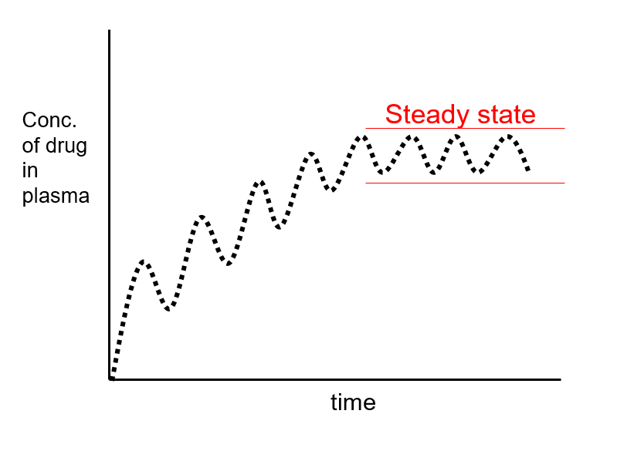
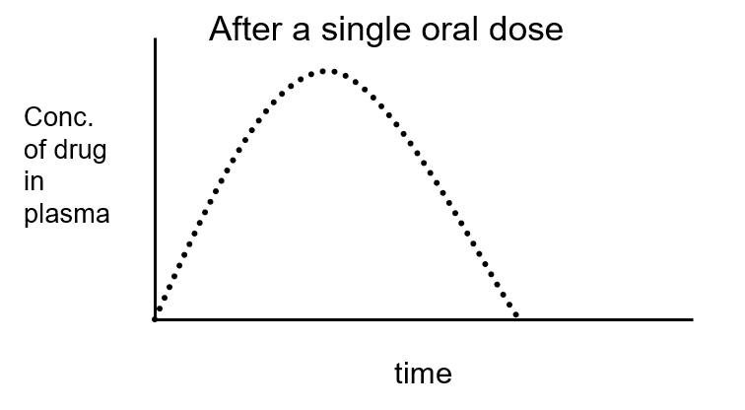
Narrow Therapeutic Index Drugs
Some drugs have a small difference between the minimum effective concentration and minimum toxic concentration in the blood

Slide 47
TOXIC
THERAPEUTIC
Clinically ineffective

Slide 48
Low TI Drugs
Warfarin Bleed to death vs stroke, DVT, pulmonary embolism
Carbamazepine
Digoxin AF, HF vs digitalis toxicity (arrythmias)
Lithium mania, bipolar, self harming vs toxicity
Ciclosporin Transplant rejection vs kidney toxicity
Phenytoin
Theophylline

Slide 49
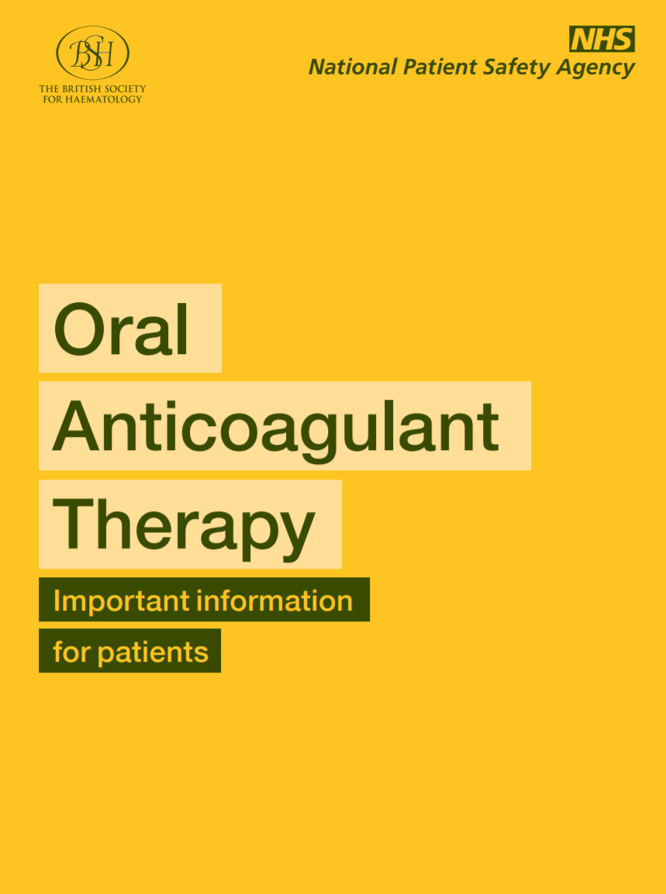
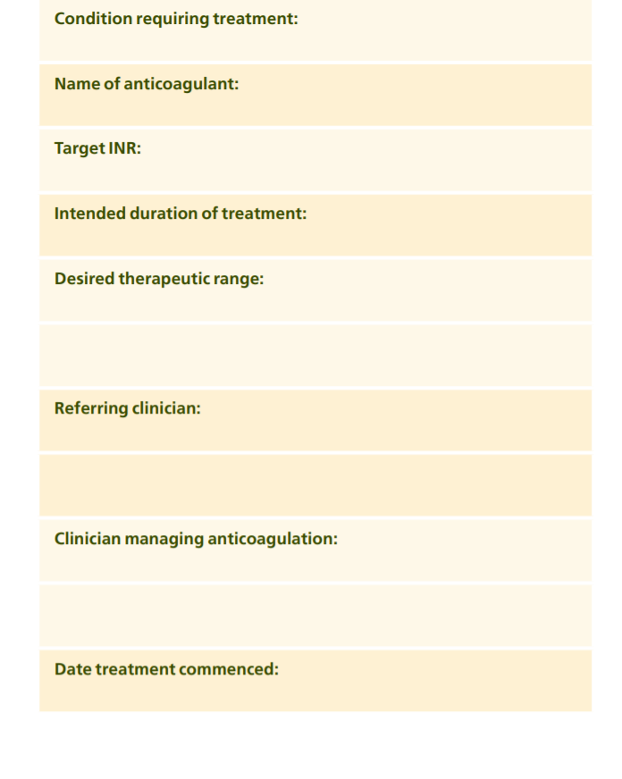
Notes:
What to record

Slide 50
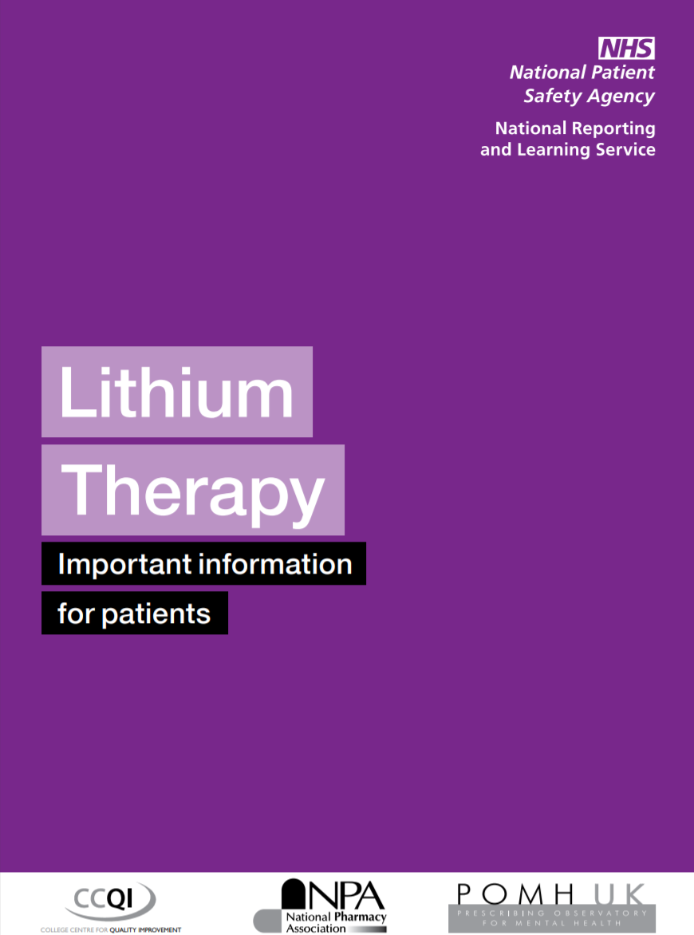
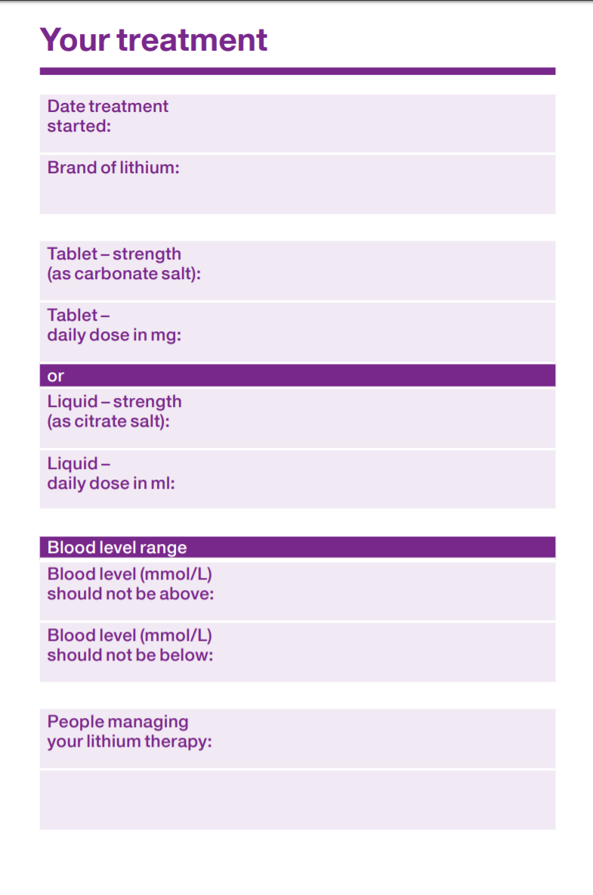
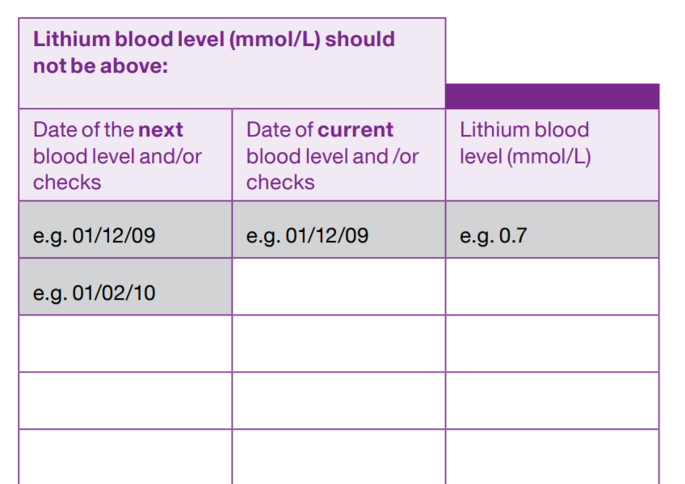
Notes:
Record?

Slide 51
Take away message
Accept you will never know all drugs/interactions
If unsure look up drugs > check interactions
More confidence in dental prescribing
Can always contact a local community pharmacist or medicines management pharmacist for further help
Record keeping
Never prescribe azole antifungals with warfarin

Slide 52
Lecture available online
https://kjmistry.co.uk/downloads

Slide 53
References
FGDP Antimicrobial prescribing standards https://www.fgdp.org.uk/antimicrobial-prescribing-standards
SDCEP Drug Prescribing in Dentistry Jan 2016 (3rd Edition) - http://www.sdcep.org.uk/published-guidance/
SDCEP Antibiotic Prophylaxis against infective endocarditis, implementation advice http://www.sdcep.org.uk/wp-content/uploads/2018/08/SDCEP-Antibiotic-Prophylaxis-Implementation-Advice.pdf
Antimicrobial Stewardship Systems and Processes - NICE Guidance 15 –August 2015
GDC Standards for Dental Team & Guidance on Prescribing Medicines
https://www.medicinescomplete.com
https://www.bnf.org
https://digital.nhs.uk/data-and-information/publications/statistical/prescribing-by-dentists/prescribing-by-dentists-england-2014#resources

Slide 54
Any Questions?

